Slide 1
HTML - meta information
Viktoras Lava www.viktoraslava.lt

Slide 2
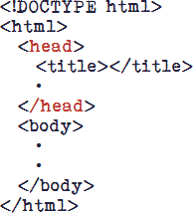
More about the <head> element and possible meta tags
Metadata typically define the document title, character set, styles, links, scripts, fonts and other meta information.

Slide 3
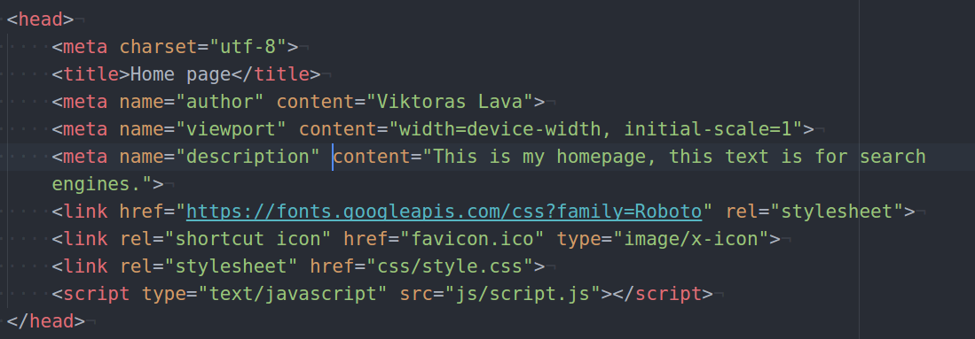
How ordinary <head> tag looks like
CSS was first proposed by Håkon Wium Lie on October 10, 1994. At the time, Lie was working with Tim Berners-Lee at CERN. CSS was developed to provide style sheets for the web.

Slide 4
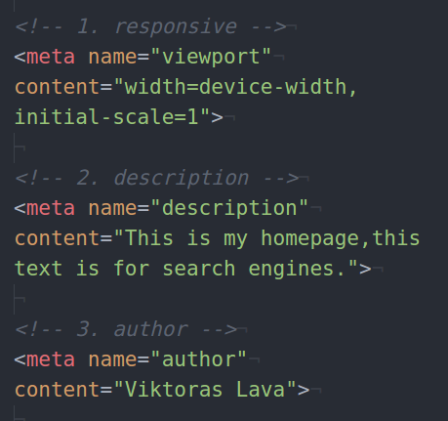
Meta tags that you need to know!
Responsive - used for defining a mobile-friendly page
Description - used for search engines, describes page content
Author - used for search engines, describes an author of the page

Slide 5
More about link tag
Mainly used for 4 things:
Adding external CSS styles
Adding text fonts
Adding icon fonts
Adding website favicon (icon)
<link>

Slide 6
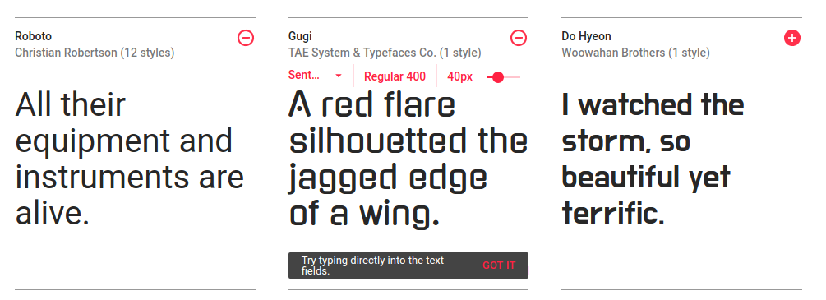
Adding text fonts (1/2)

Slide 7
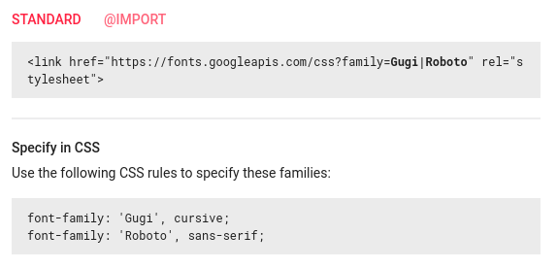
Adding text fonts (2/2)
Adding fonts is very easy. Just head to google fonts pick your font and you will find the instructions on how to add them.

Slide 8

Adding icon fonts (1/2)

Slide 9
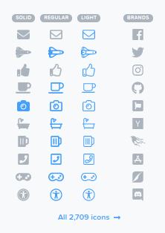
Adding icon fonts (2/2)
There are many icon fonts, but the most popular is called Font Awesome. Head to their website and find the “get started” page.

Slide 10

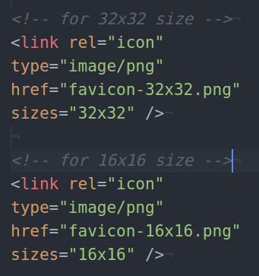
Adding website favicon (icon)
First you need to have an image, which size is 32x32 or 16x16 pixels, then you can use FAVIC-O-MATIC tool to convert your image to an .ico file. Then you can use the code on the right to add the favicon.

Slide 11

More about the <body>
Next we will talk about iframe and google maps, also about video tag.

Slide 12
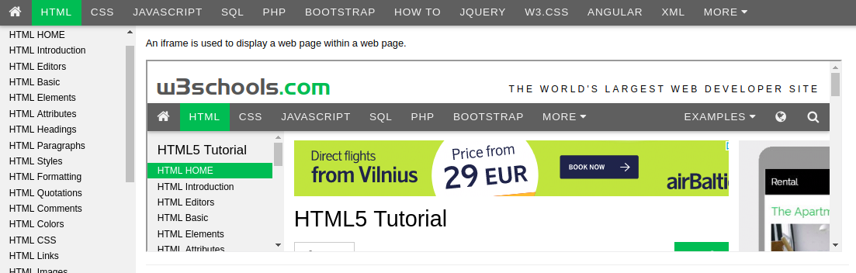
What is an iframe? (1/2)

Slide 13
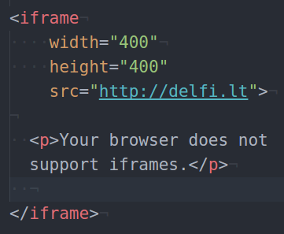
What is an iframe? (2/2)
Iframe is used to display a web page within a web page. This type of element is rarely used, because it is very slow! Nowadays mostly used to insert google maps.

Slide 14
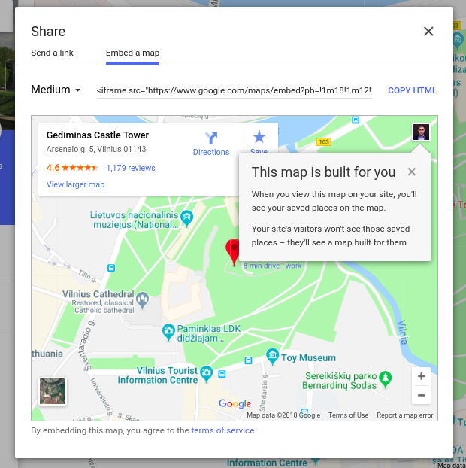
Adding google maps
Head to https://google.com/maps
Enter the desired address, for ex. Gedimino pilis
Click “Share” button
Select “Embed a map”
Copy the iframe HTML code and paste it to your website

Slide 15
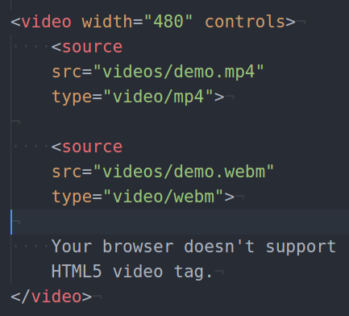
Adding video
In order to add a video to your website you need to use <video> tag with “controls” attribute. Then <source> tag, which can links your video.
The most widely used video format is .mp4. Use at least 2 different video formats for supportability.

Slide 16
Questions?

